Slide 1
WDP

Slide 2
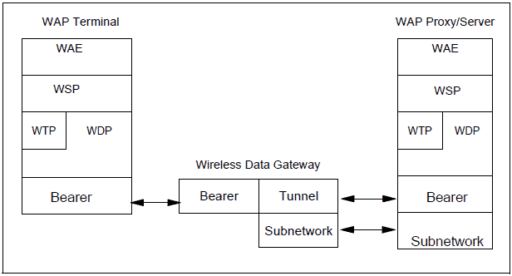

Slide 3
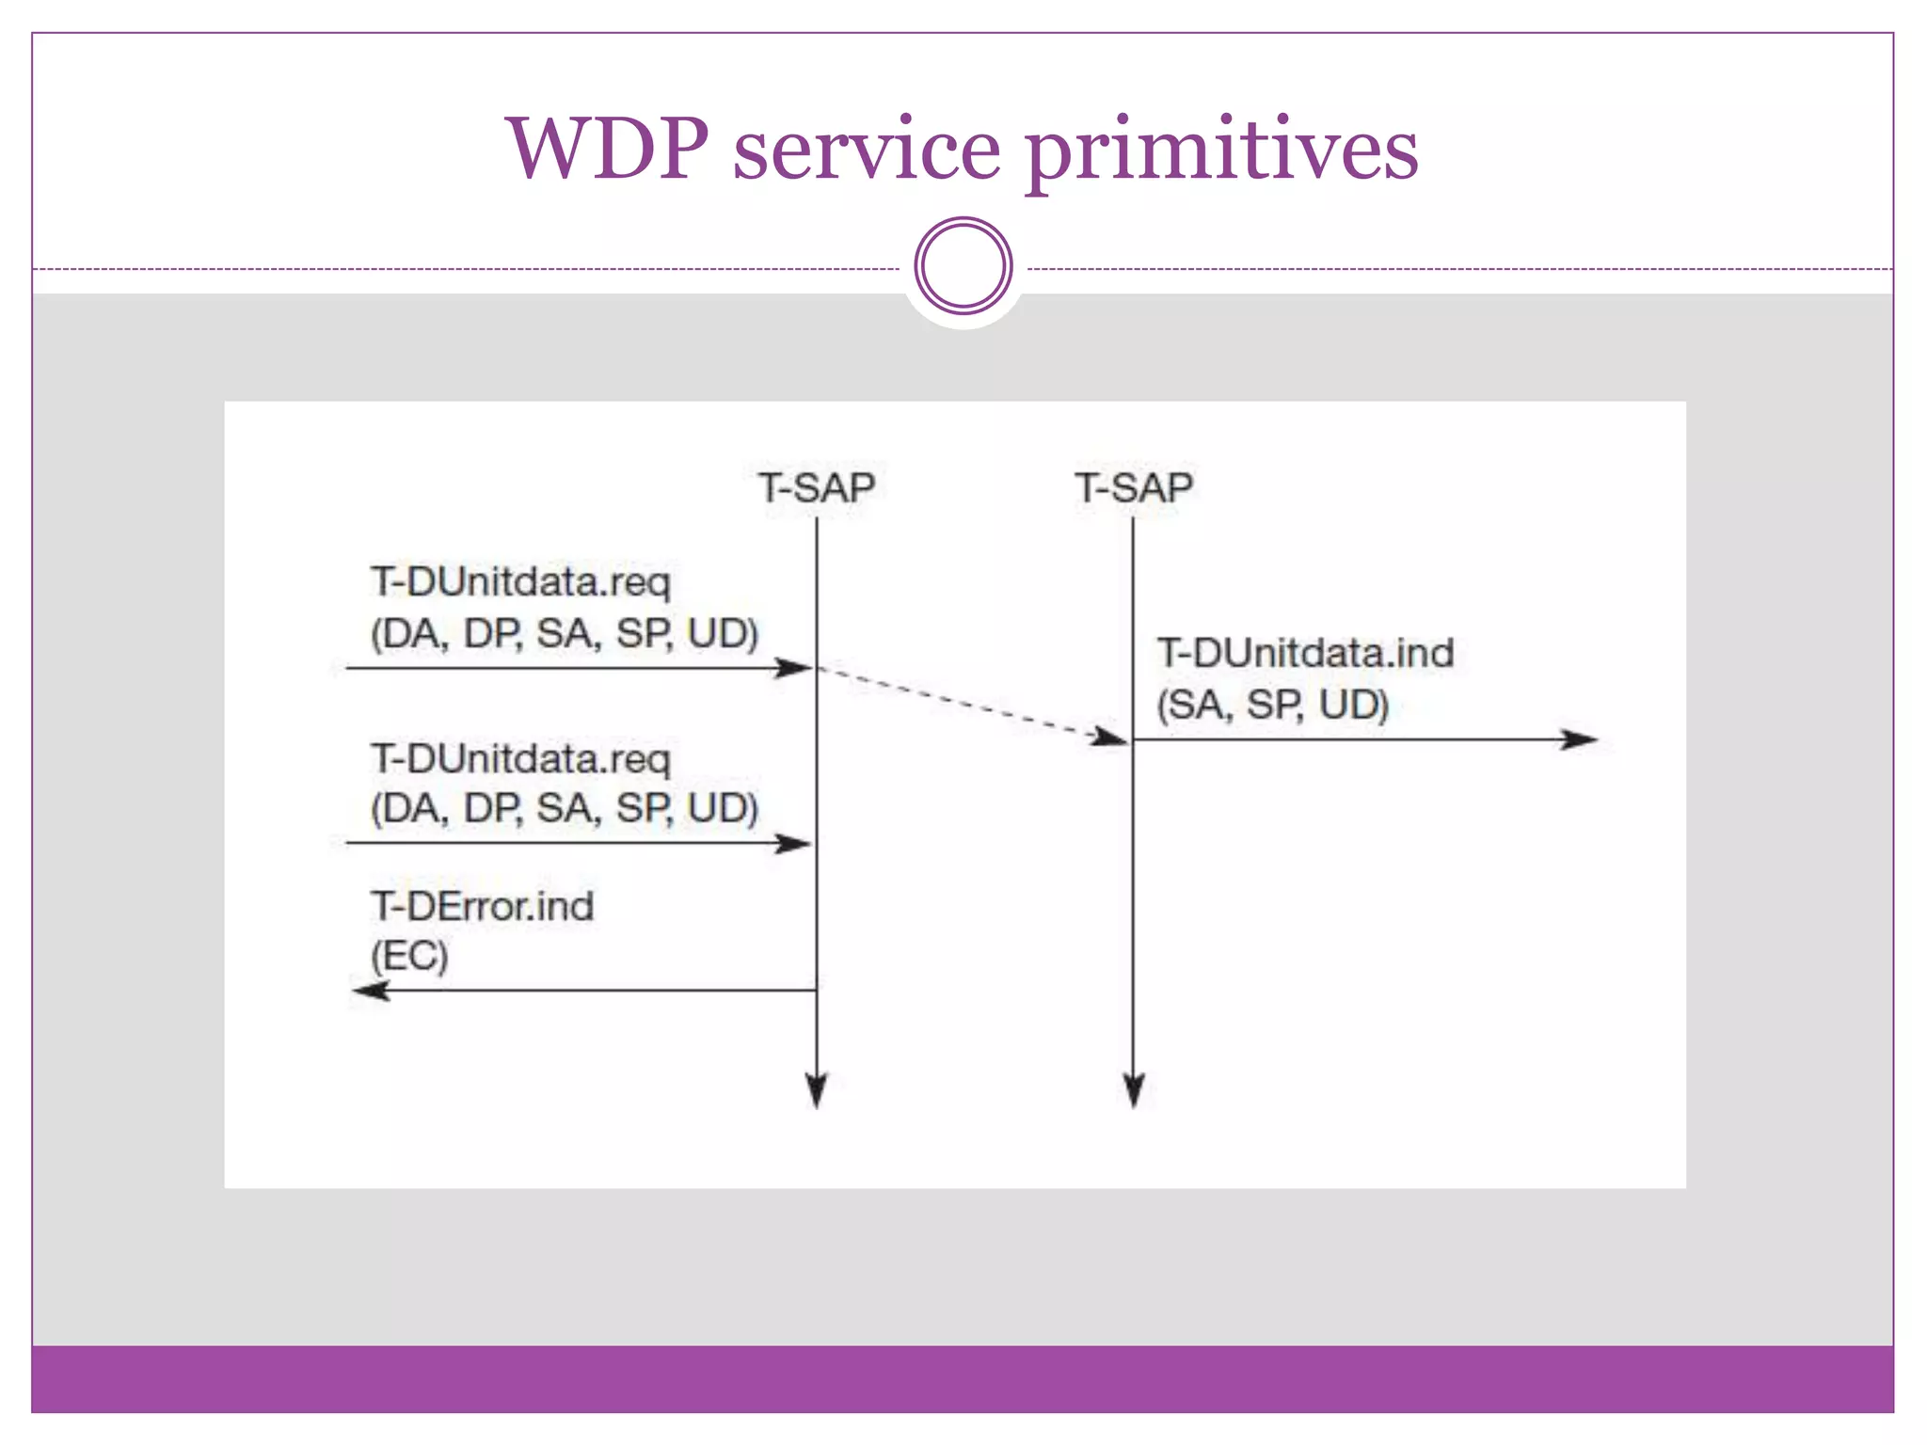

Slide 4
WTS

Slide 5
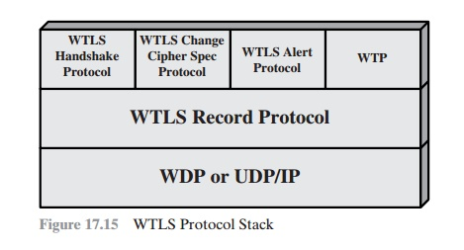

Slide 6
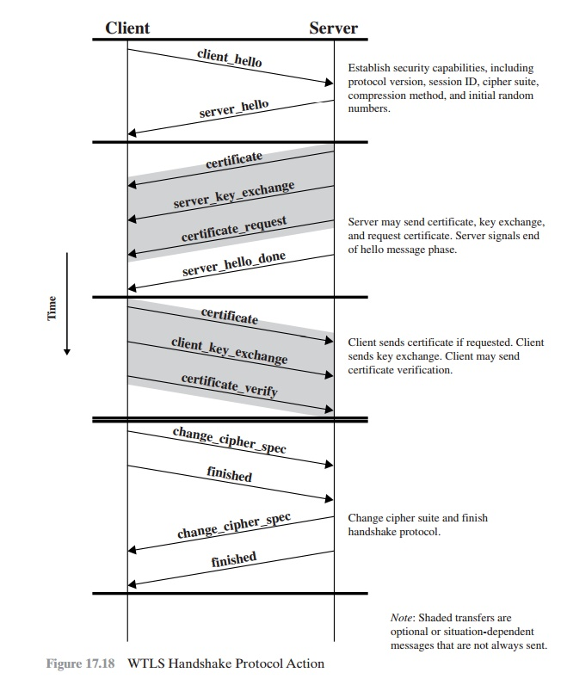

Slide 7
WSP

Slide 8
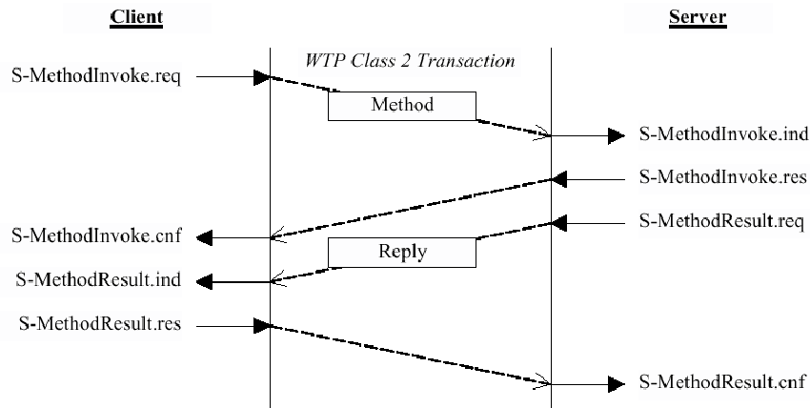

Slide 9
WAE

Slide 10
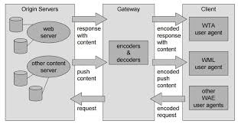

Slide 11
WTA

Slide 12
